Slide 1

APPLIED LINEAR ALGEBRA
Group 08
Inverse Matrix
Cryptography : Encryption Decryption

Slide 2
PROPOSAL OUTLINE
Introduction
Reproduced Work:
Problems With Hill Cipher Improvements Made By Us
Linear Algebra Concepts used Problem Statement
Result Conclusion References Contribution
KEY DISCUSSION POINTS
GROUP 08 : INVERSE MATRIX

Slide 3
ABOUT THE TEAM
Jevin Jivani - AU2040051 Ronit Shah - AU2040048 Shrey Somani - AU2040002

Slide 4
WORDS OF INSPIRATION
When Cryptography is outlawed, bayl bhgynjf jvyy unir cevinpl (only outlaws will have privacy)
JOHN PERRY BARLOW

Slide 5
INTRODUCTION
WHAT WE AIM TO BE
Securing data important, matter of privacy Cryptography, a technique to secure data from third party apps
Secured via Encryption and Decrypted to understand Encryption - Plaintext to Ciphertext
Decryption - Ciphertext to Plaintext
GROUP 08 : INVERSE MATRIX

Slide 6
DRAWBACKS OF HILL-CIPHER
In Hill Cipher, if the string is not a multiple of three, it adds a random letter at the end of the string to make it a multiple of three. Due to this, if the receiver decrypts the ciphertext, it will not return the original string.
Hill cipher can encrypt or decrypt messages with upper case letters only.
If the user enter a matrix that is not invertible then Hill-Cipher doesn't work.
GROUP 08 : INVERSE MATRIX

Slide 7
IMPROVEMENTS MADE BY US
In the encrypted message, we have added a special character so that in the process of decryption, we know how many characters we have to remove in plain text.
This algorithm works on every character. all uppercase letters, lowercase letters, and some special characters.
If the user enters a non-invertible matrix, then we reduce the value of the last element so that it becomes invertible.
We have added an additional feature that creates a QR-code for our cipher text, and we decrypt the message by scanning the QR-code.
GROUP 08 : INVERSE MATRIX

Slide 8
PROBLEM STATEMENT
In this Digital era, data gets utmost priority. The organization/individual who has data holds the power.
Cyber security is one of the major concern of the 21st century. Cases of data breaches and server hacks have increased every year.
Encryption plays a mojor role in this field.
It can assist safeguard private information and sensitive data, as well as improve the security of client-server communication.
GROUP 08 : INVERSE MATRIX

Slide 9
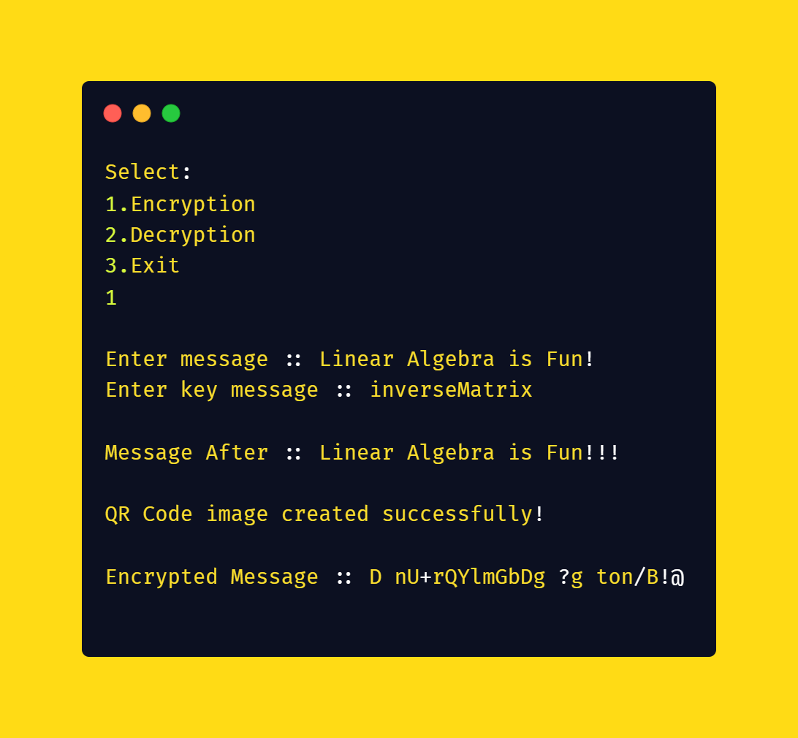
RESULTS
ENCRYPTION
GROUP 08 : INVERSE MATRIX

Slide 10
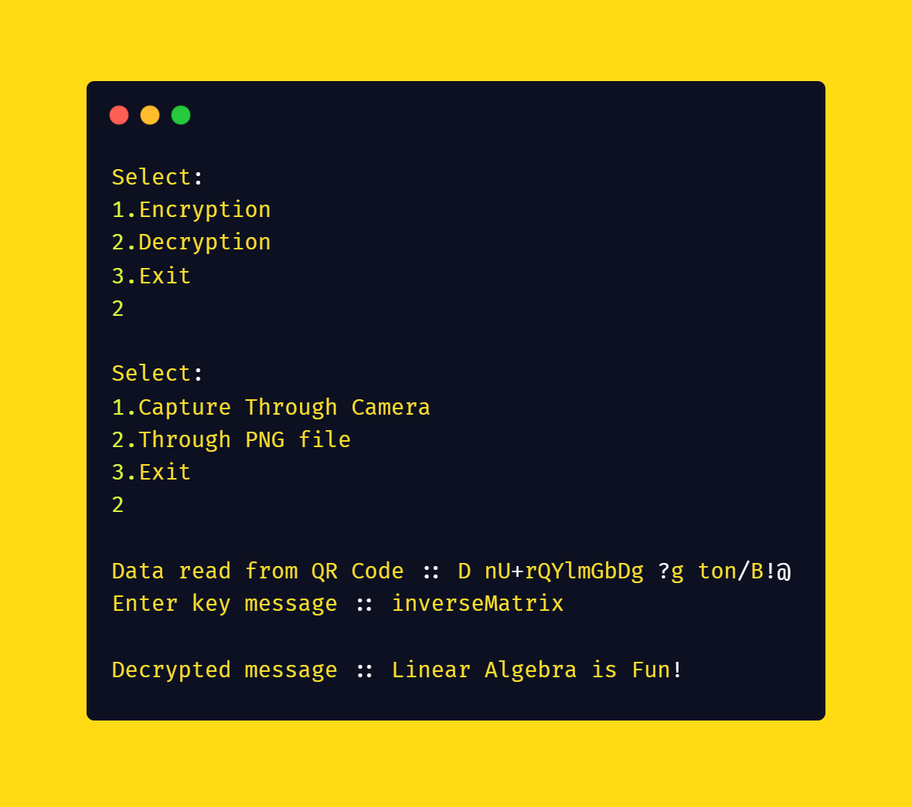
RESULTS
DECRYPTION
GROUP 08 : INVERSE MATRIX

Slide 11
RESULTS
DESCRIPTION
The length of the message to be encrypted is 22, which is not a multiple of 3.
Encrypted message has ended with "@" which indicates that 2 more letters are needed for the message to be multiple of 3.
The key is something which cannot be forgotten.
In the process of encryption, the QR-Code is generated and the same QR-Code is scanned to give cipher text in the decryption process.
Enter the key and get the original message.
GROUP 08 : INVERSE MATRIX

Slide 12
CONCLUSION
The modified Hill Cipher was very efficient in encrypting strings or messages which were not a multiple of 3.
Special characters like '!' and even uppercase letters are accepted in the modified Hill Cipher.
The original cipher did not convert the encrypted message into a QR Code but the modified version made by us makes a QR Code making it difficult to break through the cipher.
The spaces between words were not accepted in the original cipher.
GROUP 08 : INVERSE MATRIX

Slide 13
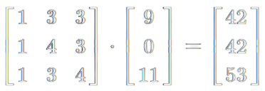
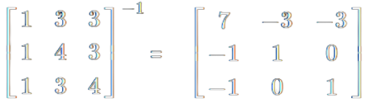
LINEAR ALGEBRA CONCEPTS USED
Multiplication of Matrix.
_
Inverse of Matrix
GROUP 12 : INVERSE MATRIX

Slide 14
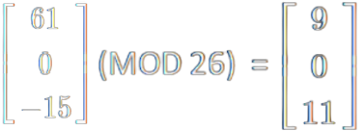
LINEAR ALGEBRA CONCEPTS USED
Modulation of Matrix.
Determinate of Matrix
GROUP 08 : INVERSE MATRIX

Slide 15
REFRENCES
Howard Anton, Chris Rorres (2005), Elementary Linear Algebra, Application Version 9th Edition, Wiley India.
https://www.amazon.in/Elementary-Linear-Algebra-Applications-Solutions/dp/0471433292
Isha Upadhyay (2021, January 5), Hill Cipher: A Comprehensive Guide, Jigsaw Academy. https://www.jigsawacademy.com/blogs/cyber-security/hill-cipher/
Murray Eisenberg, Hill ciphers and modular linear algebra, mimeographed notes, University of Massachusetts, 1998, 19 pages
https://apprendre-en-ligne.net/crypto/hill/Hillciph.pdf
GROUP 08 : INVERSE MATRIX

Slide 16
CONTRIBUTION
JEVIN JIVANI
Researched about encryption algorithm. Coded the main content of the Project.
Contribution in Modified Hill-Cipher. Prepared slides for presentation.
Found the relevant details which are used in the project like articles, useful links.
GROUP 08 : INVERSE MATRIX

Slide 17
CONTRIBUTION
RONIT SHAH
Prepared slides for presentation. Collected information for the content.
Analyzed the code and text encryption/decryption algorithm. Found the relevant detail which are used in the project like articles, useful links.
GROUP 08 : INVERSE MATRIX

Slide 18
CONTRIBUTION
SHREY SOMANI
Made Report for project. Prepared slides for presentation.
Analyzed the code and text encryption/decryption algorithm.
Found the relevant details which are used in the project like articles, useful links.
GROUP 08 : INVERSE MATRIX

Slide 19

GITHUB
HTTPS://GITHUB.COM/JEVINJIVANI2507/ ENCRYPTION_DECRYPTION
GROUP 08 : INVERSE MATRIX

Slide 20

Key Value : appliedLAlgebra

